Slide 1


Dr. Robin Singh Bhadoria
Associate Professor, Dept. of CEA

Slide 2
Hadoop Ecosystem
Hadoop Ecosystem is a platform or a suite which provides various services to solve the big data problems. It includes Apache projects and various commercial tools and solutions.
Apache Hadoop ecosystem refers to the various components of the Apache Hadoop software library; it includes open source projects as well as a complete range of complementary tools. Some of the most well-known tools of the Hadoop ecosystem include HDFS, Hive, Pig, YARN, MapReduce, Spark, HBase, Oozie, Sqoop, Zookeeper, etc.

Slide 3
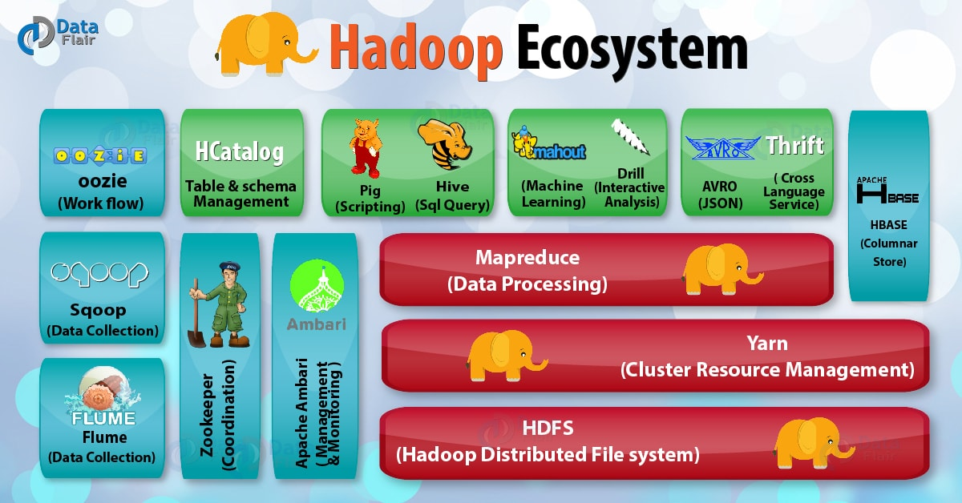

Slide 4
What is Pig?
Apache Pig is a platform for data analysis. It is procedural language.
It is an alternative to Map Reduce Programming.
Pig was developed as a research project at Yahoo.
Apache Pig is a high-level platform for creating programs that run on Apache Hadoop. The language for this platform is called Pig Latin. Pig can also execute its Hadoop jobs in MapReduce.

Slide 5
Features of Pig
It provides an engine for executing data flows (how your data should flow). Pig processes data in parallel on the Hadoop cluster.
It provides a language called “Pig Latin” to express data flows.
Pig Latin contains operators for many of the traditional data operations such as join, filter, sort, etc.
It allows users to develop their own functions (User Defined Functions) for reading, processing, and writing data.

Slide 6
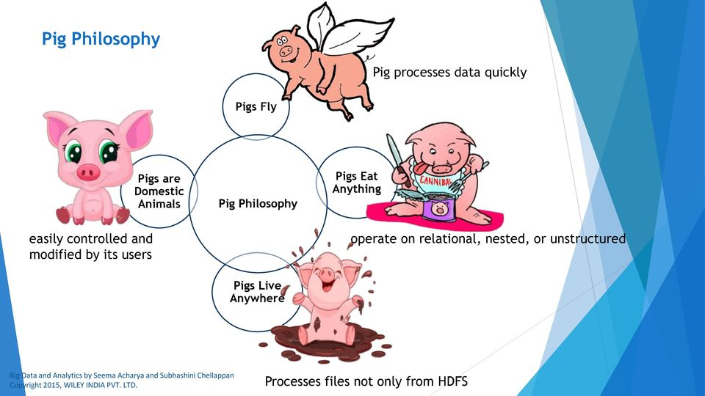
Apache Pig Philosophy

Slide 7
Apache Pig Philosophy
Pigs Eat Anything
Pig can operate on data whether it has metadata or not. It can operate on data that is relational, nested, or unstructured. And it can easily be extended to operate on data beyond files, including key/value stores, databases, etc.
Pigs Live Anywhere
Pig is intended to be a language for parallel data processing. It is not tied to one particular parallel framework. It has been implemented first on Hadoop, but we do not intend that to be only on Hadoop.
Pig is Domestic Animals
Pig is designed to be easily controlled and modified by its users.
Pig allows integration of user code where ever possible. Written in Java or scripting languages. Pig supports user provided load and store functions. Pig has an optimizer that rearranges some operations in Pig Latin scripts to give better performance, combines Map Reduce jobs together, etc.
Pigs Fly
Pig processes data quickly. We want to consistently improve performance, and not implement features in ways that weigh pig down so it can't fly.

Slide 8
The Anatomy of Pig
The main components of Pig are as follows:
Data flow language (Pig Latin).
Interactive shell where you can type Pig Latin statements (Grunt).
Pig interpreter and execution engine.

Slide 9
Pig on Hadoop
Pig runs on Hadoop.
Pig uses both Hadoop Distributed File System and MapReduce Programming.
By default, Pig reads input files from HDFS. Pig stores the intermediate data (data produced by MapReduce jobs) and the output in HDFS.
However, Pig can also read input from and place output to other sources.

Slide 10
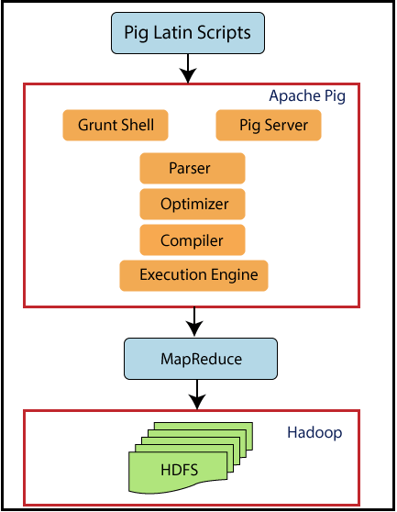
Pig Architecture

Slide 11
Component of Pig Architecture
Parser-Initially the Pig Scripts are handled by the Parser. It checks the syntax of the script, does type checking, and other miscellaneous checks. The output of the parser will be a DAG (directed acyclic graph), which represents the Pig Latin statements and logical operators.
Optimizer-The logical plan (DAG) is passed to the logical optimizer, which carries out the logical optimizations such as projection and pushdown.
Compiler- The compiler compiles the optimized logical plan into a series of MapReduce jobs.
Execution engine-Finally the MapReduce jobs are submitted to Hadoop in a sorted order. Finally, these MapReduce jobs are executed on Hadoop producing the desired results.

Slide 12
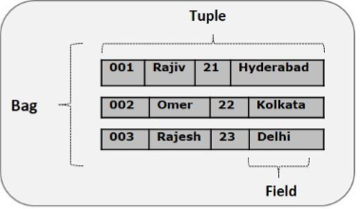
Pig Latin Data Model

Slide 13
Pig Latin Data Model
Atom-Any single value in Pig Latin, which is stored as String.
Tuple-A record that is formed by an ordered set of fields
Bag-A bag is an unordered set of tuples. In other words, a collection of tuples
Map-A map (or data map) is a set of key-value pairs. The key needs to be of type chararray and should be unique. e.g.− [name#Raja, age#30]
Relation-A relation is a bag of tuples.

Slide 14
Apache Pig | MapReduce
It is a scripting language. | It is a compiled programming language.
Abstraction is at higher level. | Abstraction is at lower level.
It have less line of code as compared to MapReduce. | Lines of code is more.
Less effort is needed for Apache Pig. | More development efforts are required for MapReduce.
Code efficiency is less as compared to MapReduce. | As compared to Pig efficiency of code is higher.

Slide 15
When to use Pig?
Pig can be used in the following situations:
When data loads are time sensitive.
When processing various data sources.
When analytical insights are required through sampling.

Slide 16
When NOT to use Pig?
Pig should not be used in the following situations:
When data is completely unstructured such as video, text, and audio.
When there is a time constraint because Pig is slower than MapReduce jobs.

Slide 17
PIG at YAHOO
Yahoo uses PIG for two things:
In Pipelines, to fetch log data from its web servers and to perform cleansing to remove companies interval views and clicks.
In Research, script is used to test a theory. Pig provides facility to integrate Perl or Python script which can be executed on a huge dataset.

Slide 18
Pig Vs. Hive
Features | Pig | Hive
Used By | Programmers and Researchers | Analyst
Used For | Programming | Reporting
Language | Procedural data flow language | SQL Like
Suitable For | Semi - Structured | Structured
Schema / Types | Explicit | Implicit
UDF Support | YES | YES
Join / Order / Sort | YES | YES
DFS Direct Access | YES (Implicit) | YES (Explicit)
Web Interface | YES | NO
Partitions | YES | No
Shell | YES | YES

Slide 19
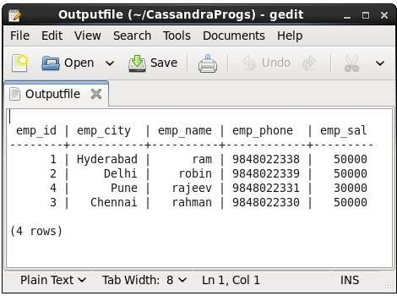

Slide 20
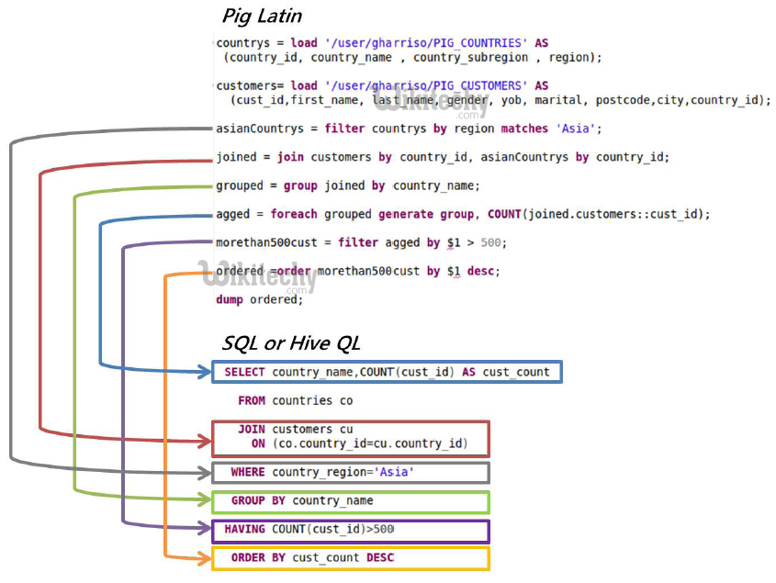

Slide 21
Pig Latin Overview: Statements
Pig Latin Statements are generally ordered as follows:
LOAD statement that reads data from the file system.
Series of statements to perform transformations.
DUMP or STORE to display/store result.
Here A is relation and NOT a variable
A = load 'student' (rollno, name, gpa);
A = filter A by gpa > 4.0;
A = foreach A generate UPPER (name);
STORE A INTO ‘myreport’

Slide 22
Pig Latin Overview: Comments
In Pig Latin two types of comments are supported:
Single line comments that begin with “--” (two hyphens).
Multiline comments that begin with “/* and end with */”.

Slide 23
Pig Latin Overview: Identifiers
Valid Identifiers
Y
A1
A1_2014
Sample

Slide 24
Pig Latin Overview: Operators
Arithmetic | Comparison | Null | Boolean
+ | = = | IS NULL | AND
- | ! = | IS NOT NULL | OR
* | < |  | NOT
/ | >
% | <=
 | >=

Slide 25
Data Types in PIG
Simple Data Types
Name | Description
int | Whole numbers
long | Large whole numbers
float | Decimals
double | Very precise decimals
chararray | Text strings
bytearray | Raw bytes
datetime | Datetime
boolean | true or false
Complex Data Types
Name | Description
Tuple | An ordered set of fields. Example: (2,3)
Bag | A collection of tuples. Example: {(2,3),(7,5)}
map | key, value pair (open # Apache)

Slide 26
Running Pig
Pig can run in two ways:
Interactive Mode
Invoke grunt Shell
Type pig to get grunt shell
A= load ‘/pigdemo/student.tsv’ as ( rollno, name, gpa );
DUMP A;
Batch Mode
Create Pig Script to run pig in batch mode
Write Pig Latin Statements in a file and save it “.pig” extension

Slide 27
Execution Modes of Pig
You can execute pig in two modes:
Local Mode
You need to have your files in local file system
Pig –x local filename
Map Reduce Mode (Default Mode)
You need to have access to a Hadoop Cluster to read/write file.
pig filename

Slide 28
Relational Operators
FILTER
FOREACH
GROUP
DISTINCT
LIMIT
ORDERBY
JOIN
UNION
SPLIT
SAMPLE

Slide 29
FILTER-BY
Find the tuples of those student where the GPA is greater than 4.0.
A = load '/pigdemo/student.tsv' as (rollno:int, name:chararray, gpa:float);
B = filter A by gpa > 4.0;
DUMP B;
tab-separated values (tsv) file

Slide 30
FOREACH
Display the name of all students in uppercase.
A = load '/pigdemo/student.tsv' as (rollno:int, name:chararray, gpa:float);
B = foreach A generate UPPER (name);
DUMP B;

Slide 31
GROUP-BY
Group tuples of students based on their GPA.
A = load '/pigdemo/student.tsv' as (rollno:int, name:chararray, gpa:float);
B = GROUP A BY gpa;
DUMP B;

Slide 32
DISTINCT
To remove duplicate tuples of students.
A = load '/pigdemo/student.tsv' as (rollno:int, name:chararray, gpa:float);
B = DISTINCT A;
DUMP B;

Slide 33
JOIN-BY
To join two relations namely, “student” and “department” based on the values contained in the “rollno” column.
A = load '/pigdemo/student.tsv' as (rollno:int, name:chararray, gpa:float);
B = load '/pigdemo/department.tsv' as (rollno:int, deptno:int,deptname:chararray);
C = JOIN A BY rollno, B BY rollno;
DUMP C;
DUMP B;

Slide 34
SPLIT
To partition a relation based on the GPAs acquired by the students.
GPA = 4.0, place it into relation X.
GPA is < 4.0, place it into relation Y.
A = load '/pigdemo/student.tsv' as (rollno:int, name:chararray, gpa:float);
SPLIT A INTO X IF gpa==4.0, Y IF gpa<=4.0;
DUMP X;

Slide 35
Eval Functions
AVG
MAX
COUNT

Slide 36
AVG
To calculate the average marks for each student.
A = load '/pigdemo/student.csv' USING PigStorage (‘,’) as (studname:chararray,marks:int);
B = GROUP A BY studname;
C = FOREACH B GENERATE A.studname, AVG(A.marks);
DUMP C;

Slide 37
MAX
To calculate the maximum marks for each student.
A = load '/pigdemo/student.csv' USING PigStorage (‘,’) as (studname:chararray, marks:int);
B = GROUP A BY studname;
C = FOREACH B GENERATE A.studname, MAX(A.marks);
DUMP C;

Slide 38
COUNT
To count the number of elements in a bag
A = load '/pigdemo/student.csv' USING PigStorage (‘,’) as (studname:chararray, marks:int);
B = GROUP A BY studname;
C = FOREACH B GENERATE A.studname, COUNT(A);
DUMP C;

Slide 39
COMPLEX DATA TYPES: TUPLE
TUPLE is an ordered collection of fields.
(John,12) (Jack,13)
(Joseph,5) (Smith,8)
(James, 7) (Scott,12)
A = LOAD '/root/pigdemos/studentdata.tsv' AS ( t1:tuple (t1a:chararray, t1b:int ), t2:tuple ( t2a:chararray, t2b:int ) ;
B = FOREACH A GENERATE t1.t1a,t1.t1b,t2$0,t2$1;
DUMP B

Slide 40
COMPLEX DATA TYPES: MAP
MAP represents a key/value pair.
John [city#Bangalore]
Jack [city#Pune]
James [city#Chennai]
A = load '/root/pigdemos/studentcity.tsv' Using PigStorage as (studname:chararray,m:map[chararray]);
B = foreach A generate m#'city' as CityName:chararray;
DUMP B

Slide 41
PIGGY BANK
Pig user can use Piggy Bank function in Pig Latin script and they can also share their functions in Piggy Bank.upper function.
Objective: To use Piggy Bank string UPPER function.
register '/root/pigdemos/piggybank-0.12.0.jar';
A = load '/pigdemo/student.tsv' as (rollno:int, name:chararray, gpa:float);
upper = foreach A generate
org.apache.pig.piggybank.evaluation.string.UPPER(name);
DUMP upper;

Slide 42
USER-DEFINED FUNCTIONS (UDF)
Pig allows you to create your own function for complex analysis.
Write a java class and convert it into “.jar” to include this function into code.
register '/root/pigdemos/myudfs.jar';
A = load '/pigdemo/student.tsv' as (rollno:int, name:chararray, gpa:float);
upper = foreach A generate myudfs.UPPER(name);
DUMP B;

Slide 43
PARAMETER SUBSTITUTION
Pig allows you to pass parameters at runtime.
To execute the statement type below command on grunt:
Pig –param student=/pigdemo/student.tsv parameterdemo.pig
A = load ‘$student' as (rollno:int, name:chararray, gpa:float);
DUMP A;

Slide 44
DIAGNOSTIC OPERATOR
DESCRIBE : It returns the schema of a relation
A = load ‘/pigdemo/student.tsv' as (rollno:int, name:chararray, gpa:float);
DESCRIBE A;

Slide 45
WORD COUNT EXAMPLE IN PIG
lines=LOAD ‘/root/pigdemo/lines.txt’ AS (line:chararray);
words=FOREACH lines GENERATE FLATTEN ( TOKENIZE (line)) as word;
grouped=GROUP words by word;
wordcount = FOREACH grouped GENERATE group, COUNT (words);
DUMP wordcount;
TOKENIZE splits the line into a field for each word.
FLATTEN will take the collection of records returned by TOKENIZE and produce a separate record for each one, calling the single field in the record word.

